Slide 1
The Wedge Hypothesis
Among-site wedge
+
Within-site wedge
=
Network wedge
g
g
g
G
G
G

Slide 2
Among-site wedge
alpha.mu
alpha_{j}
g
beta_{j}
alpha_{j}
alpha.sigma
beta.mu
Sites = 1,…,j
beta_{j}
mean 0
beta.sigma
G
Within-site wedge
sig.alpha.mu
g
sig.alpha_{j}
sigma_{i}
ln(sigma)
sig.alpha.sigma
sig.alpha_{j}
sig.beta.mu
sig.beta_{j}
Sites = 1,…,j
sig.beta_{j}
mean 0
mean 0
sig.beta.sigma
G
G
Network wedge
ag.sig.alpha
g
ln(ag.sigma)
ag.sigma_{i}
ag.sig.beta
G
mean 0
G

Slide 3
Among-site diversity
no
yes
Portfolio strength = observed variance / expected variance
port.scen.1 = exp(ag.sig.alpha + ag.sig.beta*[G]) / exp(sig.alpha.mu)
port.scen.2 = exp(ag.sig.alpha + ag.sig.beta*[G]) / ???
port.scen.3 = exp(ag.sig.alpha + ag.sig.beta*[G]) / exp(sig.alpha.mu + sig.beta.mu*[G])
no
Within-site diversity
Scenario 1
Scenario 2
Portfolio strength
more diversity than expected
yes
port.scen.3
1
port.scen.1
Scenario 3
Observed
less diversity than expected
G

Slide 4
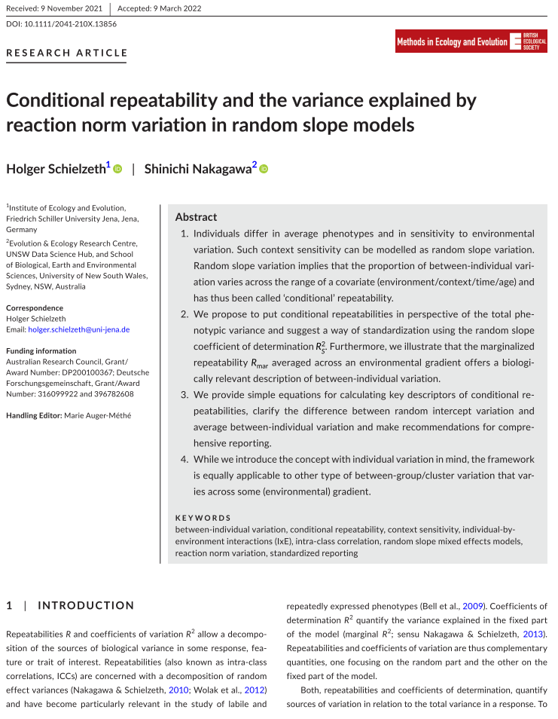
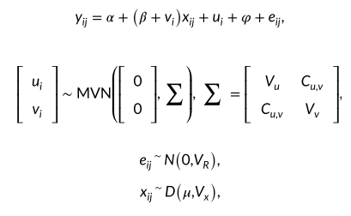
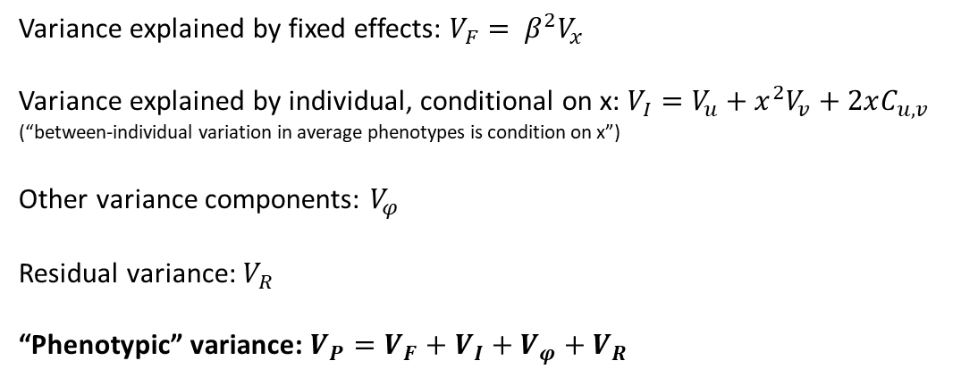
Random intercept, random slope model (with correlation structure):
Variance explained by fixed effects: $V_{F}= β^{2}V_{x}$
Variance explained by individual, conditional on x: $V_{I}=V_{u}+x^{2}V_{v}+2xC_{u,v}$
(“between-individual variation in average phenotypes is condition on x”)
Other variance components: $V_{φ}$
Residual variance: $V_{R}$
“Phenotypic” variance: $V_{P}=V_{F}+V_{I}+V_{φ}+V_{R}$

Slide 5
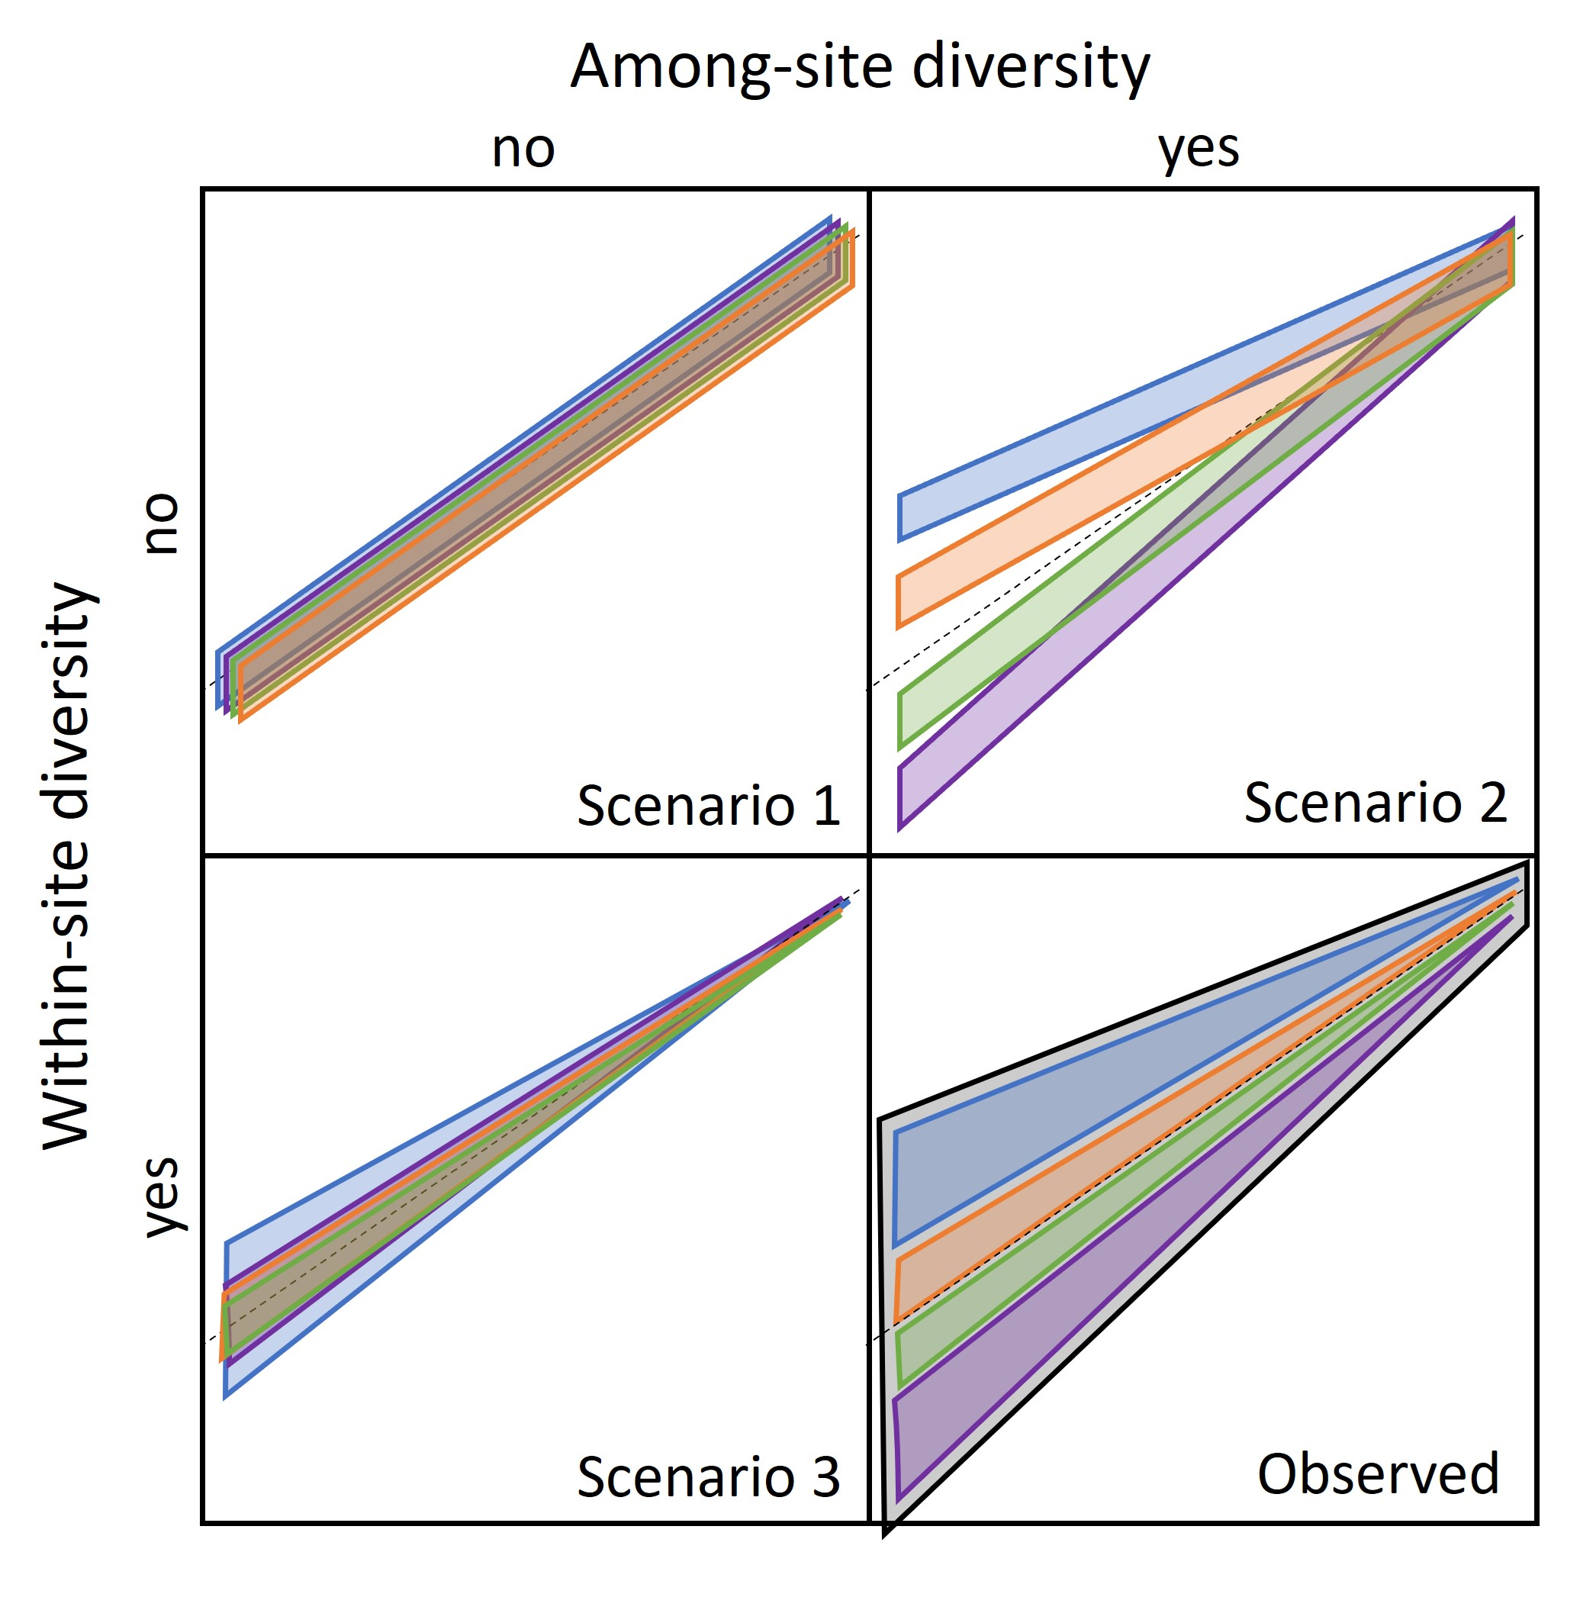
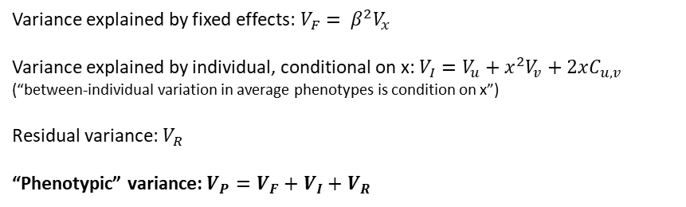
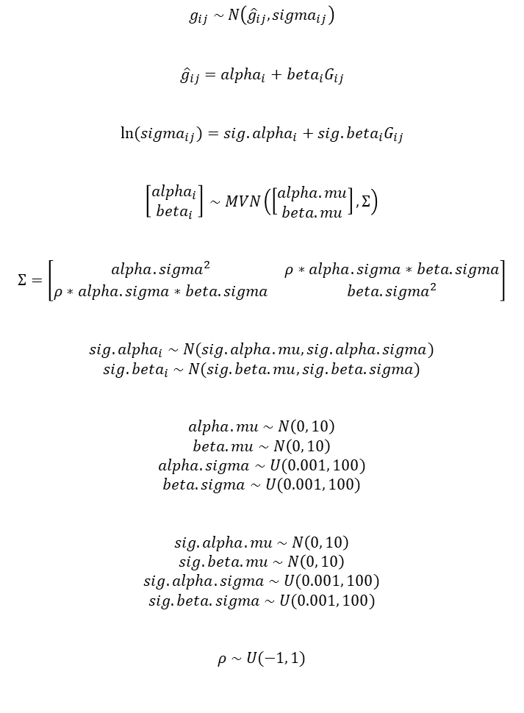
Variance explained by fixed effects: $V_{F}= β^{2}V_{x}$
Variance explained by individual, conditional on x: $V_{I}=V_{u}+x^{2}V_{v}+2xC_{u,v}$
(“between-individual variation in average phenotypes is condition on x”)
Residual variance: $V_{R}$
“Phenotypic” variance: $V_{P}=V_{F}+V_{I}+V_{R}$
$$g_{ij} \sim N\left({\hat{g}}_{ij}, {sigma}_{ij}\right)$$
$${\hat{g}}_{ij}={alpha}_{i}+{beta}_{i}G_{ij}$$
$$\ln{({sigma}_{ij})}={sig.alpha}_{i}+{sig.beta}_{i}G_{ij}$$
$$\left[\begin{matrix}{alpha}_{i} \\ {beta}_{i}\end{matrix}\right] \sim MVN\left(\left[\begin{matrix}alpha.mu \\ beta.mu\end{matrix}\right], Σ\right)$$
$$Σ=\left[\begin{matrix}{alpha.sigma}^{2} & ρ∗alpha.sigma∗beta.sigma \\ ρ∗alpha.sigma∗beta.sigma & {beta.sigma}^{2}\end{matrix}\right]$$
$${sig.alpha}_{i} \sim N(sig.alpha.mu, sig.alpha.sigma)$$
$${sig.beta}_{i} \sim N(sig.beta.mu, sig.beta.sigma)$$
$$alpha.mu \sim N\left(0, 10\right)$$
$$beta.mu \sim N\left(0, 10\right)$$
$$alpha.sigma \sim U(0.001, 100)$$
$$beta.sigma \sim U(0.001, 100)$$
$$sig.alpha.mu \sim N\left(0, 10\right)$$
$$sig.beta.mu \sim N\left(0, 10\right)$$
$$sig.alpha.sigma \sim U(0.001, 100)$$
$$sig.beta.sigma \sim U(0.001, 100)$$
$$ρ \sim U(−1, 1)$$
$$V_{P,Obs}= \left({beta.mu}^{2}V_{x}\right)+\left({alpha.sigma}^{2}+x^{2}{beta.sigma}^{2}+2x\left(ρ∗alpha.sigma∗beta.sigma\right)\right)+{\left(e^{sig.alpha.mu+sig.beta.mu∗x}\right)}^{2}$$
$$V_{P,1}= \left({beta.mu}^{2}V_{x}\right)+{\left(e^{sig.alpha.mu}\right)}^{2}$$
$$V_{P,2}= \left({beta.mu}^{2}V_{x}\right)+\left({alpha.sigma}^{2}+x^{2}{beta.sigma}^{2}+2x\left(ρ∗alpha.sigma∗beta.sigma\right)\right)+{\left(e^{sig.alpha.mu}\right)}^{2}$$
$$V_{P,3}= \left({beta.mu}^{2}V_{x}\right)+{\left(e^{sig.alpha.mu+sig.beta.mu∗x}\right)}^{2}$$
Ignores site-level differences in flow effects on sigma
In S&N model, hierarchical intercepts/slopes are modeled as offsets to global parameters

